Slide 1

The evidence for the impact of good quality career guidance
Tristram Hooley, Presentation to QICS providers, 24th February 2015

Slide 2
Overview
What makes for quality career guidance?
Advancing Ambitions
  Method
  Critique of policy
  The value of career guidance to social mobility
  Quantifying the impacts
  What does good look like?
Where next?
Questions/discussion

Slide 3
Overview
What makes for quality career guidance?
Advancing Ambitions
  Method
  Critique of policy
  The value of career guidance to social mobility
  Quantifying the impacts
  What does good look like?
Where next?
Questions/discussion

Slide 4
OECD definition
Career guidance refers to services and activities intended to assist individuals, of any age and at any point throughout their lives, to make educational, training and occupational choices and to manage their careers…
The activities may take place on an individual or group basis, and may be face-to-face or at a distance (including help lines and web-based services).
(OECD, 2004)

Slide 5
Existing research says
Career education and guidance are good things!
They are positively associated with a range of benefits including:
Retaining young people in the education system (reducing absence and drop out)
Increasing attainment
Supporting smooth transitions to further learning and work
Underpinning lifelong career building

Slide 6
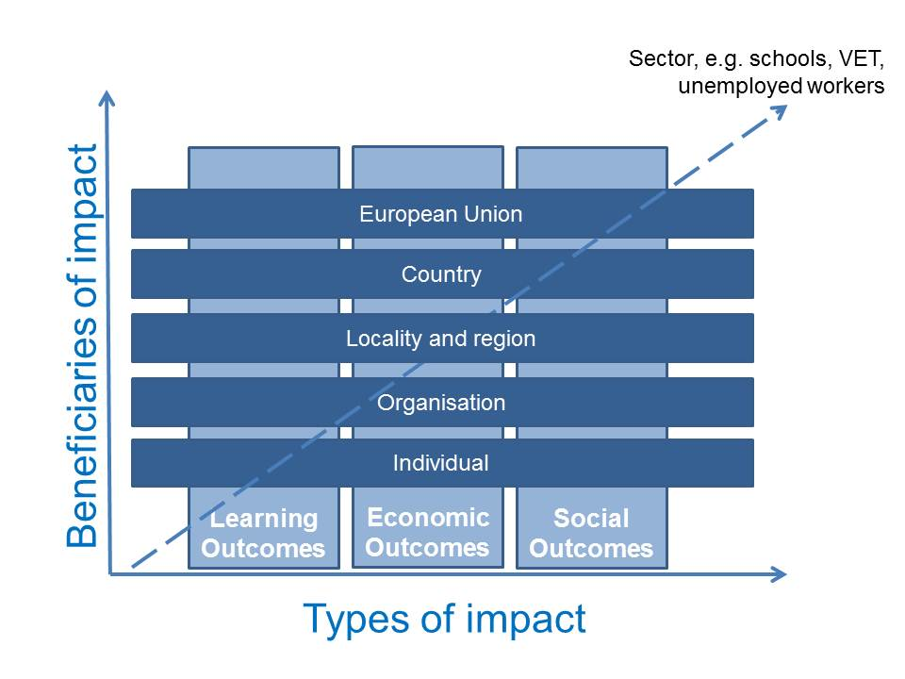
The impacts of lifelong guidance

Slide 7
Good career guidance (Gatsby)
A stable careers programme
Learning from career and labour market information
Addressing the needs of each pupil
Linking curriculum learning to careers
Encounters with employers and employees
Experiences of workplaces
Encounters with further and higher education
Personal guidance

Slide 8
Overview
What makes for quality career guidance?
Advancing Ambitions
  Method
  Critique of policy
  The value of career guidance to social mobility
  Quantifying the impacts
  What does good look like?
Where next?
Questions/discussion

Slide 9
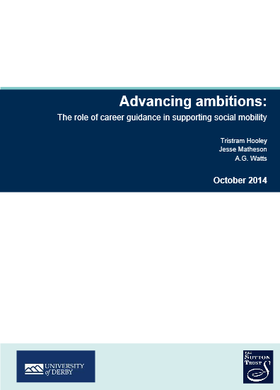

Slide 10
Method
Literature and policy review
Identification of a national list of 820 schools that hold QICS awards.
Analysis of schools data (including attainment, attendance and destination data) to examine the differences between QICS and non-QICS schools.
Detailed case study work with 14 schools that held QICS awards.
* Note this is not an evaluation of QICS. QICS was used as a proxy for quality careers provision.

Slide 11
Overview
What makes for quality career guidance?
Advancing Ambitions
  Method
  Critique of policy
  The value of career guidance to social mobility
  Quantifying the impacts
  What does good look like?
Where next?
Questions/discussion

Slide 12
Critique of policy
The transfer of responsibility for career guidance to schools along with other changes to the career guidance infrastructure from 2011 has resulted in:
A decline in the overall quantity of provision
A decline in the overall quality of provision
An increased patchiness of provision
None of these changes has been systematically monitored by government.

Slide 13
Overview
What makes for quality career guidance?
Advancing Ambitions
  Method
  Critique of policy
  The value of career guidance to social mobility
  Quantifying the impacts
  What does good look like?
Where next?
Questions/discussion

Slide 14
Career guidance’s contribution to social mobility
Provide access to information and intelligence about the labour and learning markets in ways that transcend existing social networks
Demystify labour and learning market systems.
Engage with individuals’ assumptions about themselves and the world around them
Listen to individuals’ aspirations and help them to operationalise these as well as considering alternatives.
Build the skills that people need to make decisions and transitions and to progress in their career (career management skills).
Broker access to networks.
Provide mentoring and support to encourage persistence and remaining resilient in the face of setbacks.

Slide 15
Overview
What makes for quality career guidance?
Advancing Ambitions
  Method
  Critique of policy
  The value of career guidance to social mobility
  Quantifying the impacts
  What does good look like?
Where next?
Questions/discussion

Slide 16
Quantifying the impacts
At GCSE, good quality career guidance was associated with
  an improvement in GCSE performance
  a decrease in persistent unexplained absences.
At A-level, good quality career guidance was associated with
  a decrease in persistent unexplained absences
  an increase in A-level performance (in state schools and sixth form colleges)
  improved destinations, with a higher proportion of A-level students destined for top-third higher education institutions and a lower proportion of A-level students with NEET outcomes.

Slide 17
Overview
What makes for quality career guidance?
Advancing Ambitions
  Method
  Critique of policy
  The value of career guidance to social mobility
  Quantifying the impacts
  What does good look like?
Where next?
Questions/discussion

Slide 18
What does good look like: Case study findings
Infrastructure: buy-in from senior leaders and governors; link to the school mission; dedicated staff or resources; systematic record keeping.
Career education programmes
Involvement of stakeholders including employers and post-secondary providers
Provision of individualised support

Slide 19
Overview
What makes for quality career guidance?
Advancing Ambitions
  Method
  Critique of policy
  The value of career guidance to social mobility
  Quantifying the impacts
  What does good look like?
Where next?
Questions/discussion

Slide 20
Where next?
Putting quality awards at the heart of career guidance policy?
Investment in more detailed evaluation of the quality awards?
Repeating this project with more detailed data analysis (student level rather than school level data).
Optimising the quality awards and using them as the basis of a RCT.

Slide 21
In print
Hooley, T., Matheson, J. & Watts, A.G. (2014). Advancing Ambitions: The role of career guidance in supporting social mobility. London: Sutton Trust.
Also see
Hooley, T. (2012). Progression in Kent: Schools taking charge. Maidstone: Kent Country Council.
Hooley, T. (2014). The Evidence Base on Lifelong Guidance. Jyväskylä, Finland: European Lifelong Guidance Policy Network (ELGPN).
Hooley, T., Marriott, J. & Sampson, J.P. (2011). Fostering College and Career Readiness: How Career Development Activities in Schools Impact on Graduation Rates and Students' Life Success. Derby: International Centre for Guidance Studies, University of Derby.
Hooley, T., Marriott, J., Watts, A.G. and Coiffait, L. (2012). Careers 2020: Options for Future Careers Work in English Schools. London: Pearson.
Hooley, T. & Watts, A.G. (2011). Careers Work with Young People: Collapse or Transition? Derby: International Centre for Guidance Studies, University of Derby.
Langley, E., Hooley, T., Bertuchi, D. (2014). A Career Postcode Lottery? Local Authority Provision of Youth and Career Support Following the 2011 Education Act. Derby: International Centre for Guidance Studies, University of Derby.

Slide 22
In conclusion
The evidence gathered through this project suggests that there are some identifiable impacts associated with career guidance.
Recent policy has not been evidence based in any way.
There is much still to do in developing the evidence base.
The quality awards could be an important part of future evidence gathering.

Slide 23
Tristram Hooley
Professor of Career Education
International Centre for Guidance Studies
University of Derby
http://www.derby.ac.uk/icegs
t.hooley@derby.ac.uk
@pigironjoe
Blog at
http://adventuresincareerdevelopment.wordpress.com

